Slide 1
OCF Certification
Mitch Kettrick OCF Certification Program Manager cpm@openconnectivity.org

Slide 2
Certification Overview
OCF’s Certification Work Group oversees the OCF Certification Program
Several documents are written / maintained to support this:
Certification Test Requirements (CTR) document (essentially the ‘test spec’)
Certification Procedure Requirements (CPR) document (the ‘process’ of certifying)
Certification Requirements Status List (CRSL) (which tests must pass to get certified)
Certification utilizes two major OCF-maintained tools*
OCF Certification Management System (OCMS) – website submission and tracking
Conformance Test Tool (CTT) – performs all the identified tests in the CTR
* Access to the OCMS and CTT are restricted to OCF Member Company representatives.

Slide 3
OCF Certification Management System (OCMS)
The OCMS is a web-based application that is used to track Devices through the OCF certification process
Once certification is complete, the information in the OCMS will be used to populate the Certified Products List on the OCF website
Go to https://cms.openconnectivity.org
login or create an account (OCF members only)
Click “Create OCF Product”
Fill out applicable / required information
Click “Add new PICS”
Provide information about the product
Click “Create PICS”
Click “Save” to create the Platform
The CTT Configuration Files (PICS) are then listed at the top of the page

Slide 4
Conformance Test Tool (CTT)
The CTT is a Windows-based application used to validate that a Device is conformant to the OCF Specifications
In order to properly test a Platform, the CTT requires a configuration file generated by the OCMS called the PICS
Indicates what features are implemented
Defines what role(s) the Platform is implementing
Provides additional testing information for features that require user interaction
The CTT uses this information to determine which test cases apply to the Implementation Under Test (IUT)
For official certification, the testing must be done by an Authorized Test Lab
The CTT is available to members for R&D and pre-certification testing

Slide 5
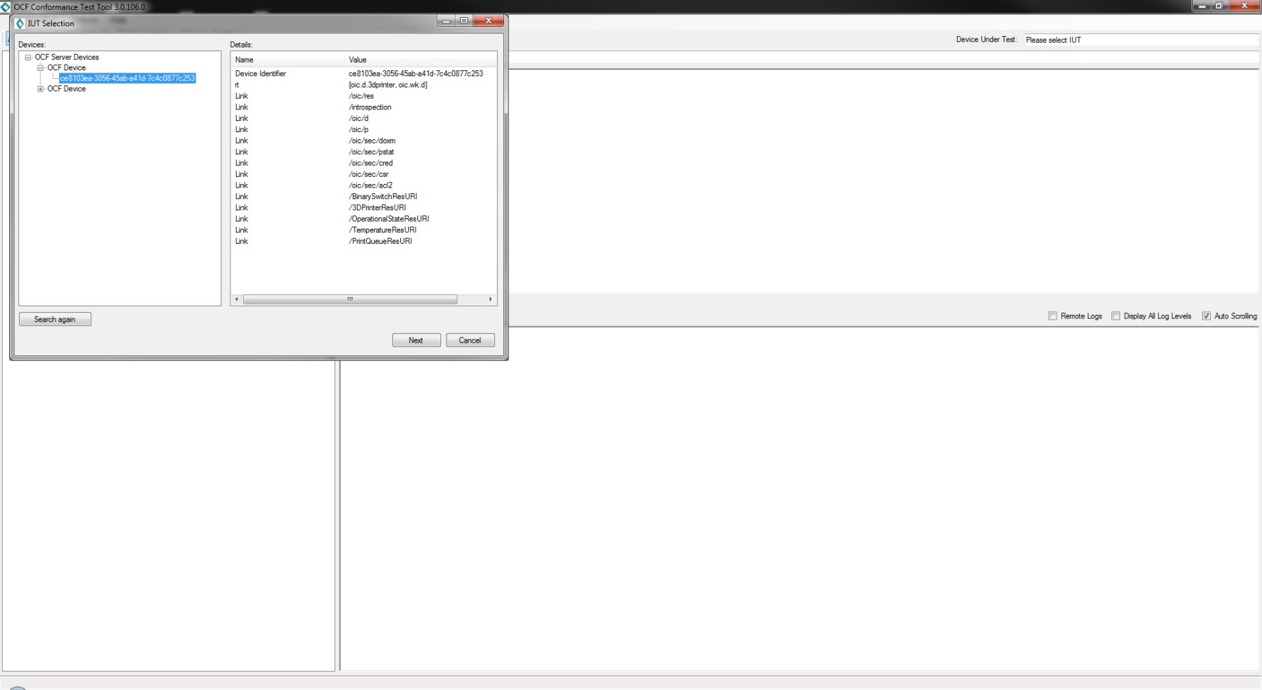
CTT Step 1: Select the IUT
Install the CTT
Select the network interface (Options ->Network Interface)
You may have to disable the firewall because it may block some network traffic
Select the IUT (File -> Select IUT)
Press Next

Slide 6
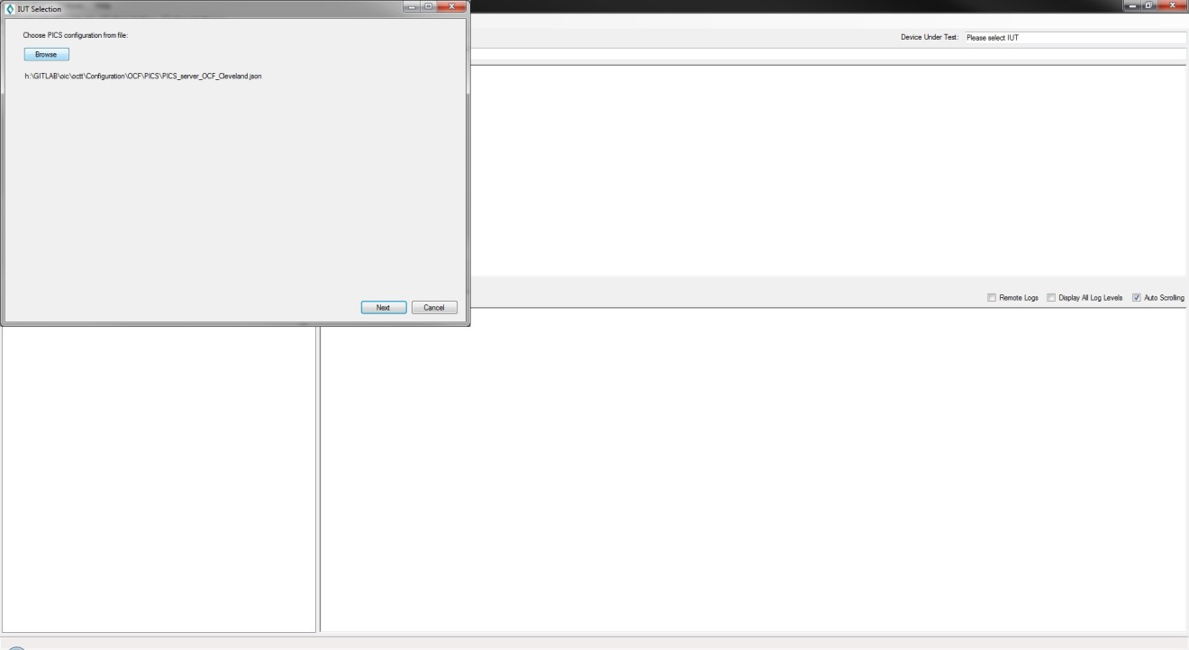
CTT Step 2: Select the PICS
Select the PICS that was generated by the OCMS
Press Next

Slide 7
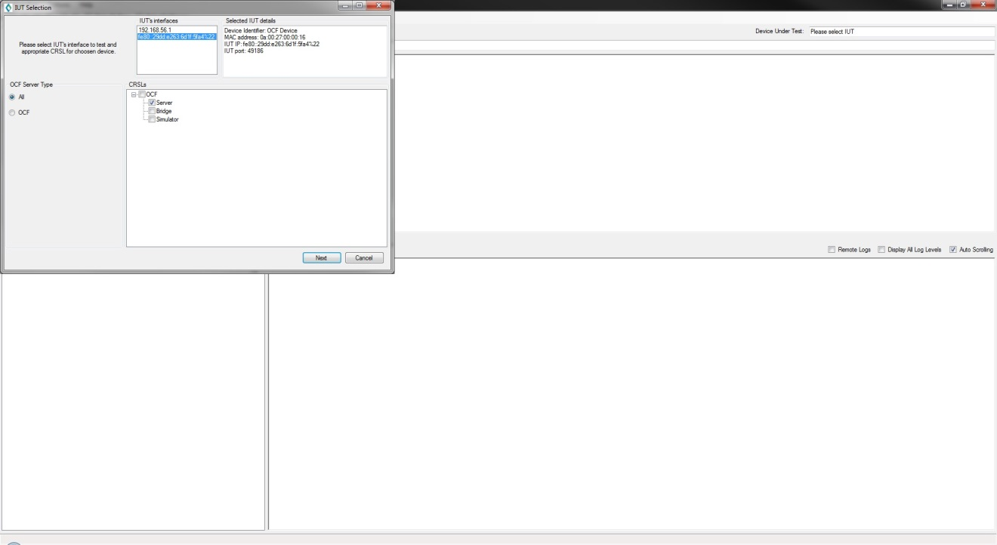
CTT Step 3: Select the CRSL
Select the IUT's interface (IPv4 or IPv6)
Select the CRSL (Server, Client, etc.)
Press Next

Slide 8
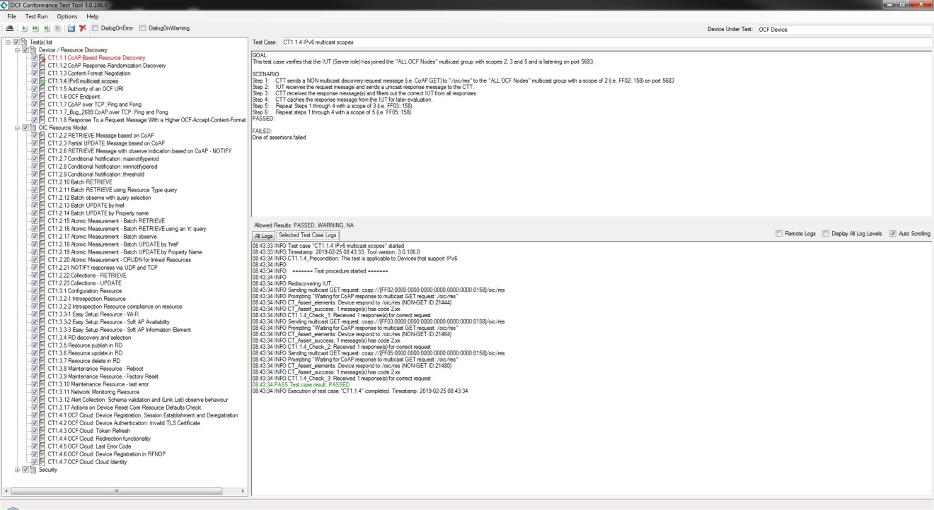
CTT Step 4: Run the test cases
Select the test cases to run
Select every test case and the CTT will only run those that apply based on the PICS
Press the play button
Passing TCs will have a green ✓
Failing TCs will have a red x
TCs not run will be grayed out
When done, press File -> Save to save a copy of your test results

